Slide 1
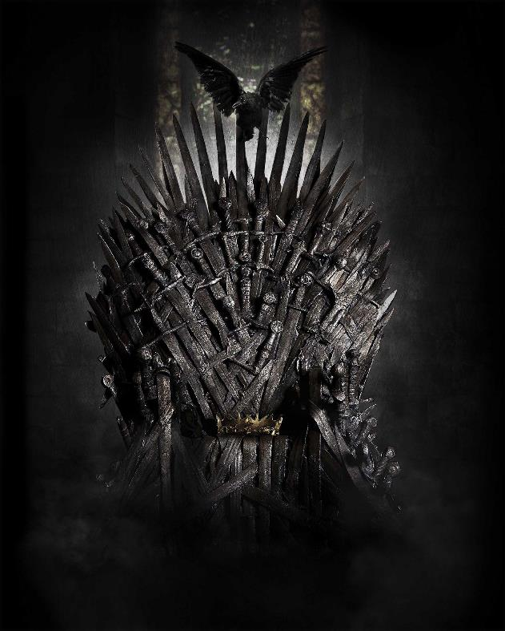

The Beginner’s Guide To
CIS/STA 9665 Term Project Final Presentation - Team 9
Notes:
Introduction - Lily (1 minute)
Research Motivations, Questions, Objectives - Jack (2 Mins)
Data including pre-processing and methods - Jingnan (2 Mins)
Analysis Q1 - Oje (3 Mins)
Analysis Q2 - Vicky (3 Mins)
Analysis Q3 and Conclusion (practical implications) - Sanket (4 Mins)

Slide 2
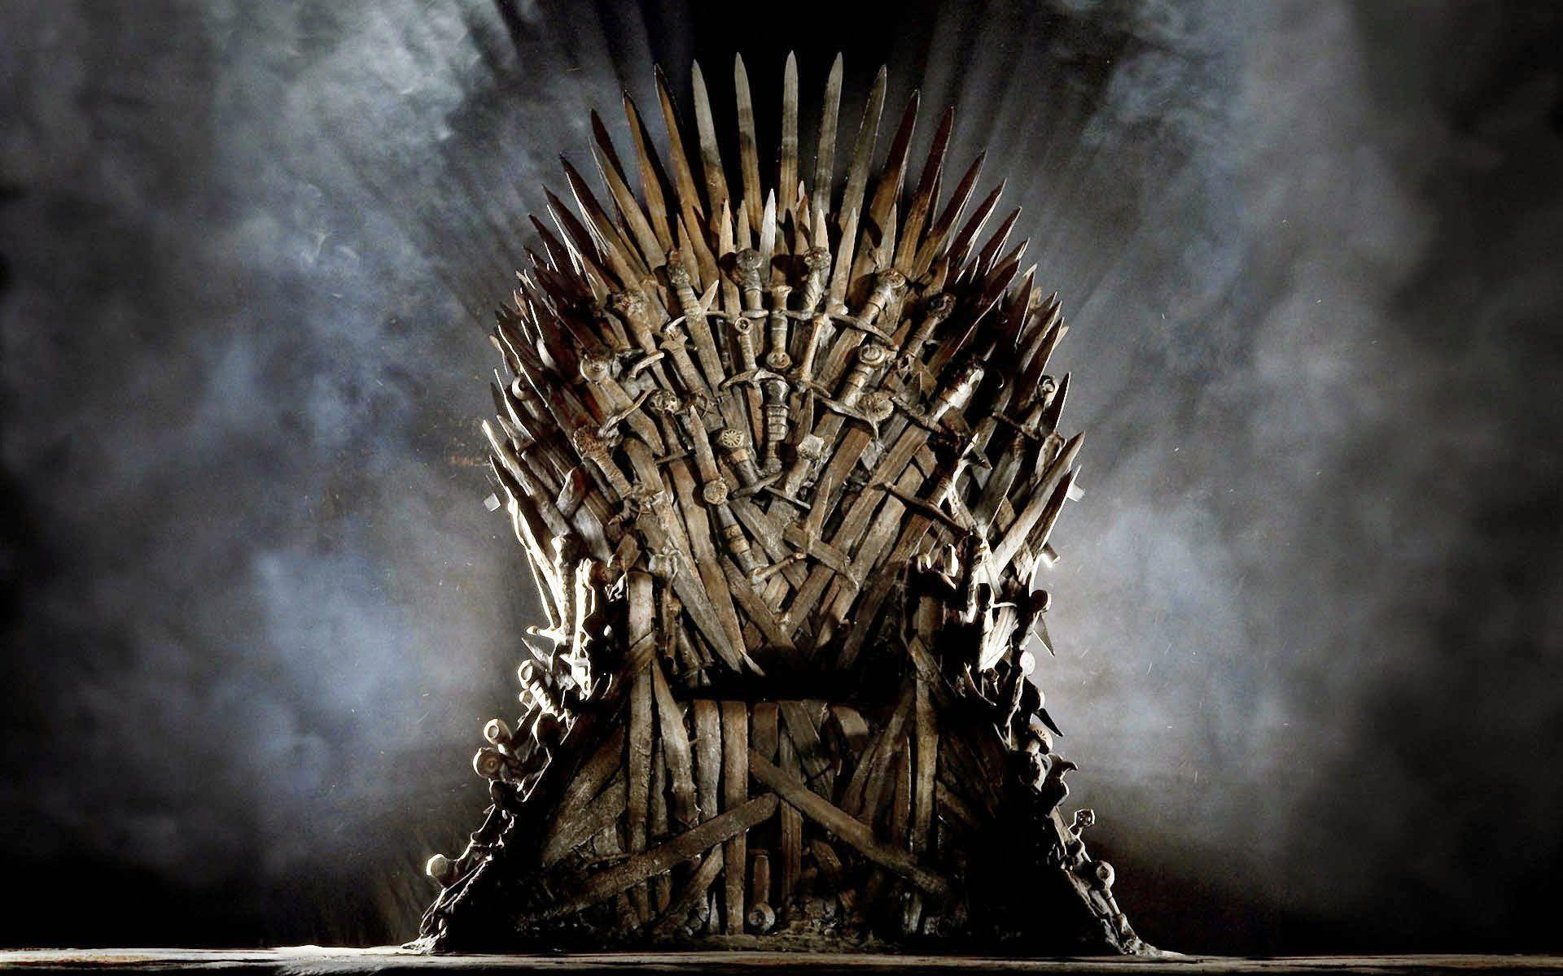

Team Members
Jack
Yang
Jingnan
Qi
Oje
Williams
Wei-Chi
Yeh
Yichuan
Hu
Sanket
Patel

Slide 3

Game Of Thrones – The Phenomenon
73
Episodes
8
Seasons
17.4 m
Average Viewership
63
Awards
10
Guinness World Records

Slide 4

Introduction and Background
According to HBO, Game of Thrones notched a series record of 17.8 million viewers.
Game of Thrones dominated the decade not because of wars and violence. It was a triumph in storytelling of characters, plot twists, dialogues, and emotions.
This project aims to help the users gain deeper insights of the story and each main character. For those who have not watched the show, it will act as a beginner’s guide to Game of Thrones.

Slide 5
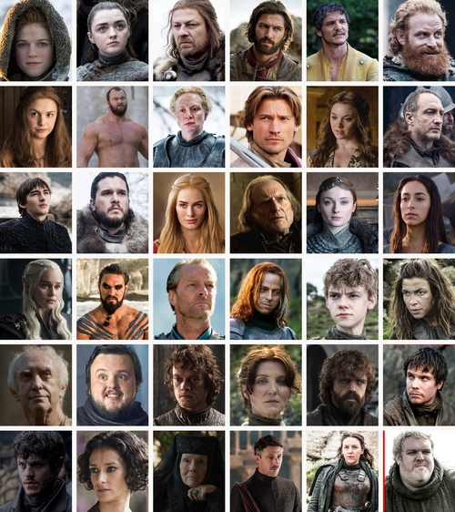
Research Motivation
According to Roz Morris, one of the bestselling ghostwriter and book doctor, characters are the heart of a novel.
This motivates us to use Sentiment Analysis to better understand the main characters in Game of Thrones.

Slide 6
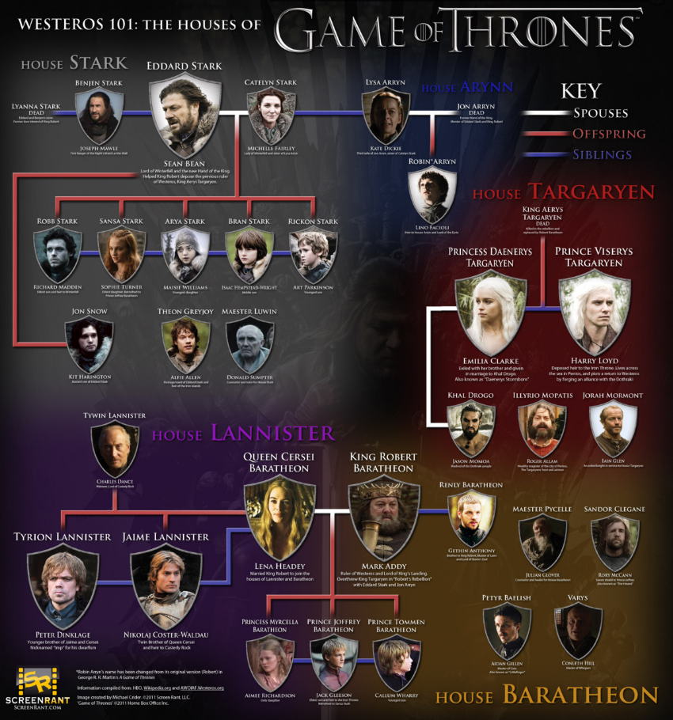
Research Motivation
According to ScienceDirect, a website that hosts over 18 million pieces of content from more than 4,000 academic journals, family influences are readily evident in a person’s acquisition of specific skills and knowledge about the world. Therefore, family makes a great influence on a person’s development of emotion and behavior.
This inspires us to explore the main families in Game of Thrones.

Slide 7
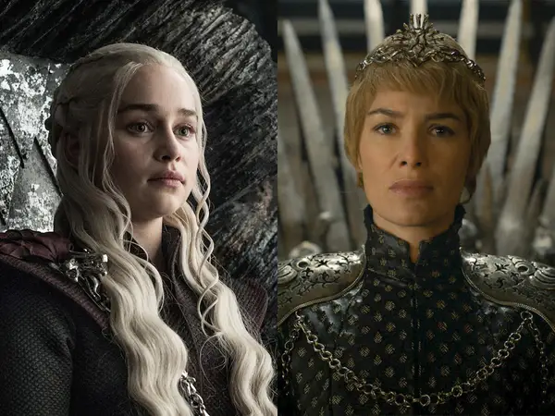
Research Motivation
In Matthew 5:7, it stated "Blessed are the merciful, for they shall obtain mercy.” Also, according to “The Art and Science of Applied Leadership”, by Dag Heward-Mills, a leader is someone who knows the importance of showing mercy.
These led us to wonder who is the better queen: Cersei or Daenerys.

Slide 8
Research Questions
How does the sentiments of characters change over time?
Between Cersei and Daenerys, who said the word “kill” more often? Who said “love” more often?
3. Based on the frequent used words, what aspect does each family reveal?

Slide 9
Research Objectives
Help the users gain a better overview of a character’s opinion behind certain scenes.
Classify the overall attitude of characters as positive, negative, or neutral.
Provide a comparison of two characters: Cersei and Daenerys.
Find the main theme in each family - what matters the most to them.

Slide 10
Text Dataset
GOT Script Dataset
Columns | Description
Release Date | Original Air Date Of Episode
Season | Season Number
Episode | Episode Number
Title | Episode Title
Name | Character Name
Sentence | Sentence Spoken
Data source : https://www.kaggle.com/albenft/game-of-thrones-script-all-seasons

Slide 11


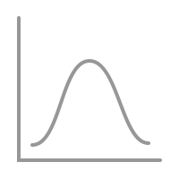

Pre - Processing Flow
Cleaning
Tokenization
Normalization
Stemming / Lemmatization

Slide 12
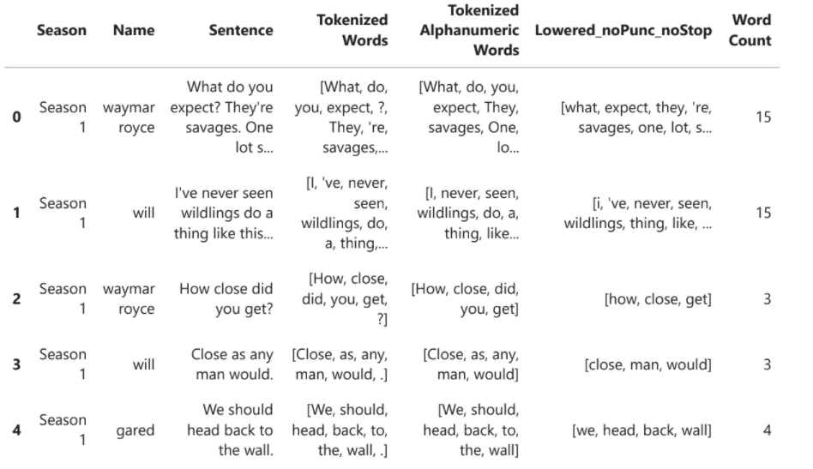
After Pre-Processing

Slide 13


Text Analysis
We used TextBlob which provides a simple API for diving into our natural language processing (NLP) task: Sentiment Analysis.
Sentiment Analysis
Aspect Mining is used as a support of noun phrase extraction for the theme of each family.
Aspect Mining

Slide 14
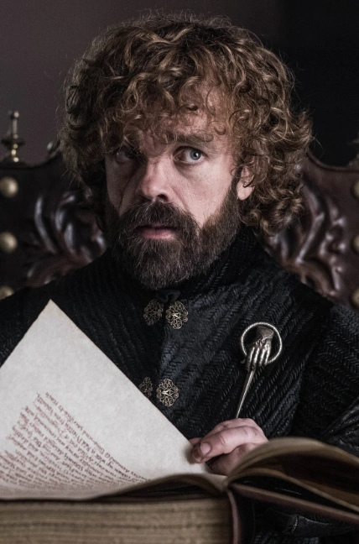
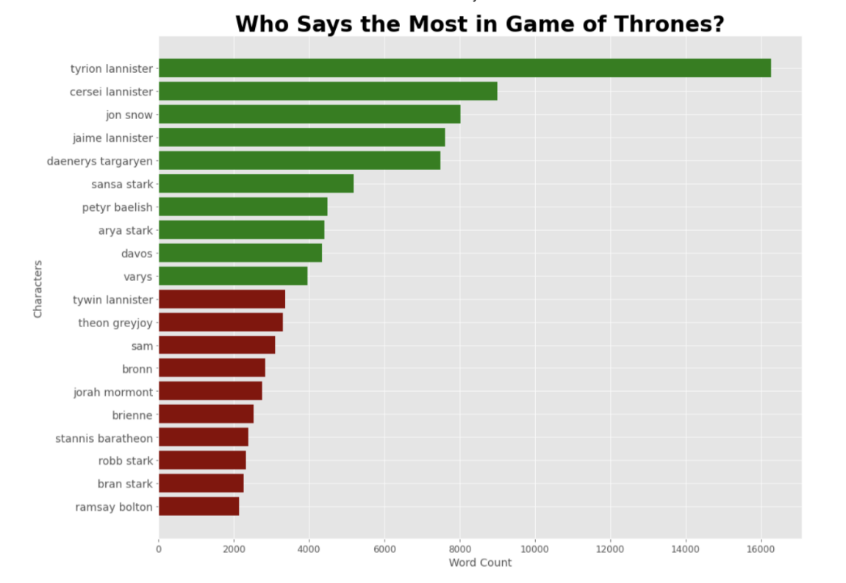
Interesting Fact

Slide 15
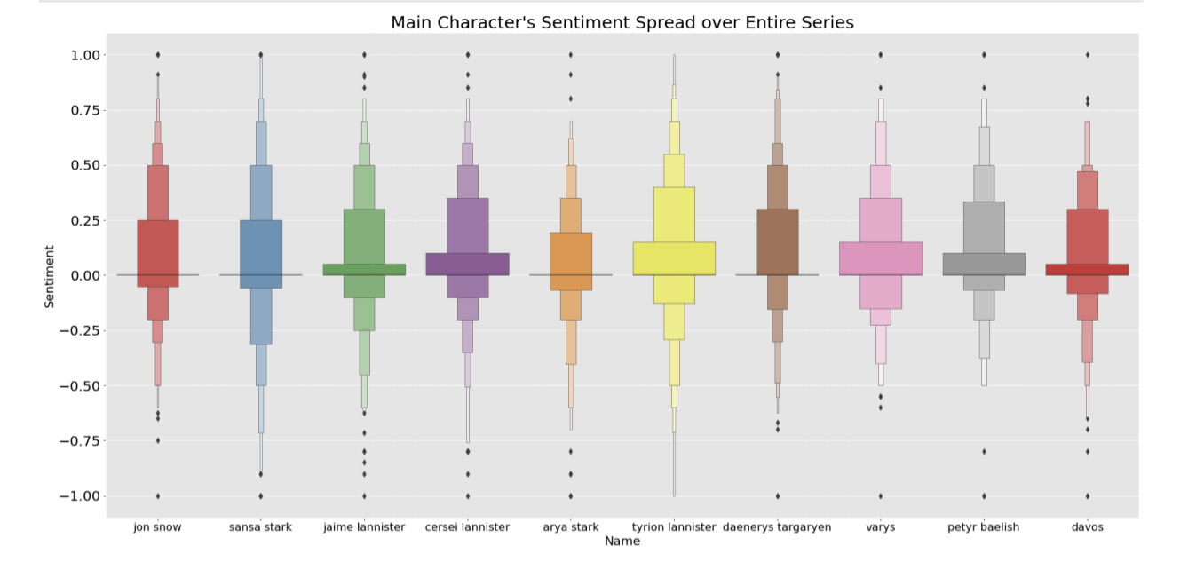
How does the sentiments of characters change over time?

Slide 16
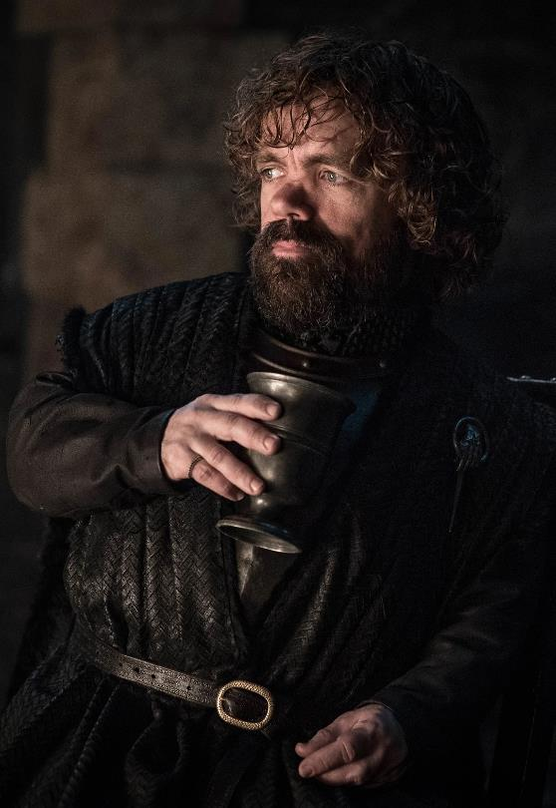
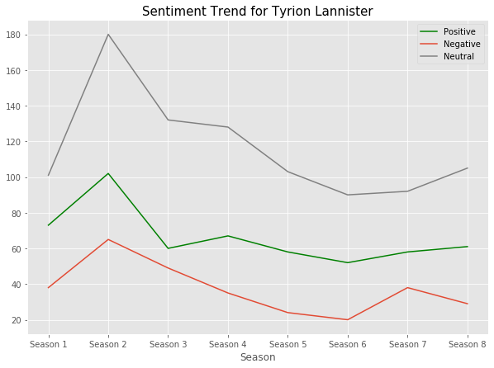
Sentiment Trend for Tyrion Lannister

Slide 17
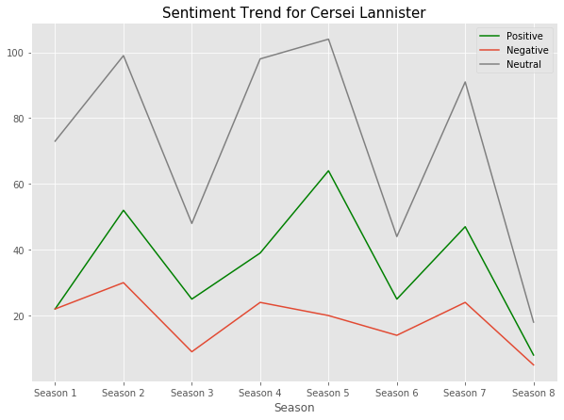
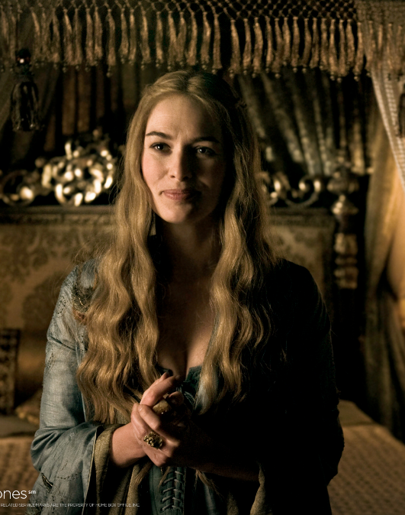
Sentiment Trend for Cersei Lannister

Slide 18
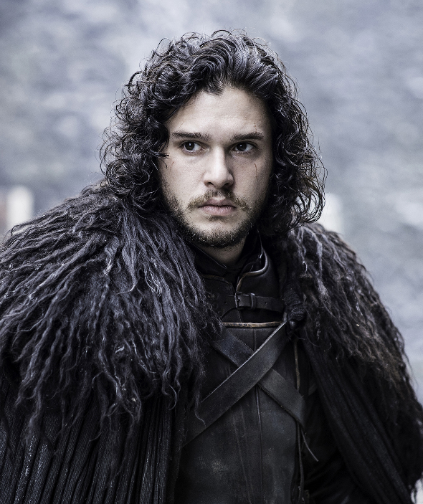
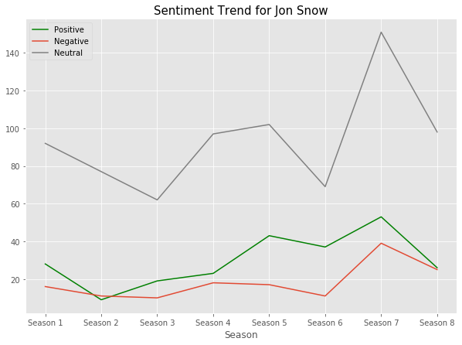
Sentiment Trend for Jon Snow

Slide 19
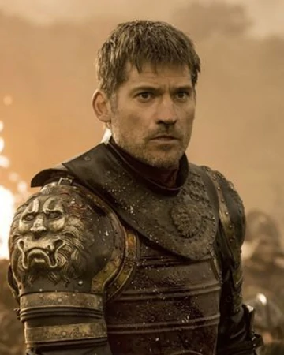
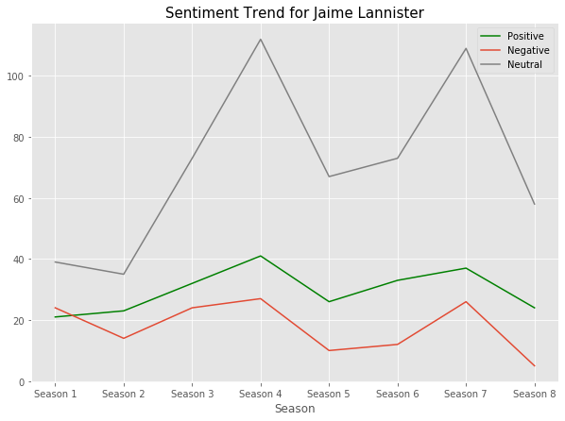
Sentiment Trend for Jaime Lannister

Slide 20
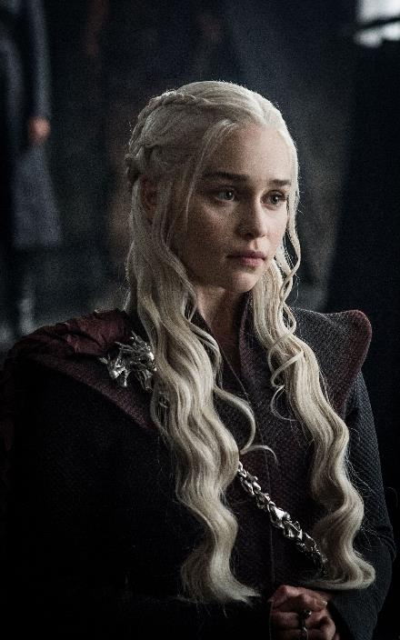
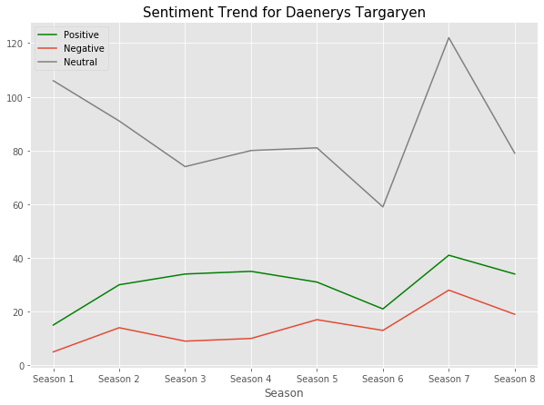
Sentiment Trend for Daenerys Targaryen

Slide 21
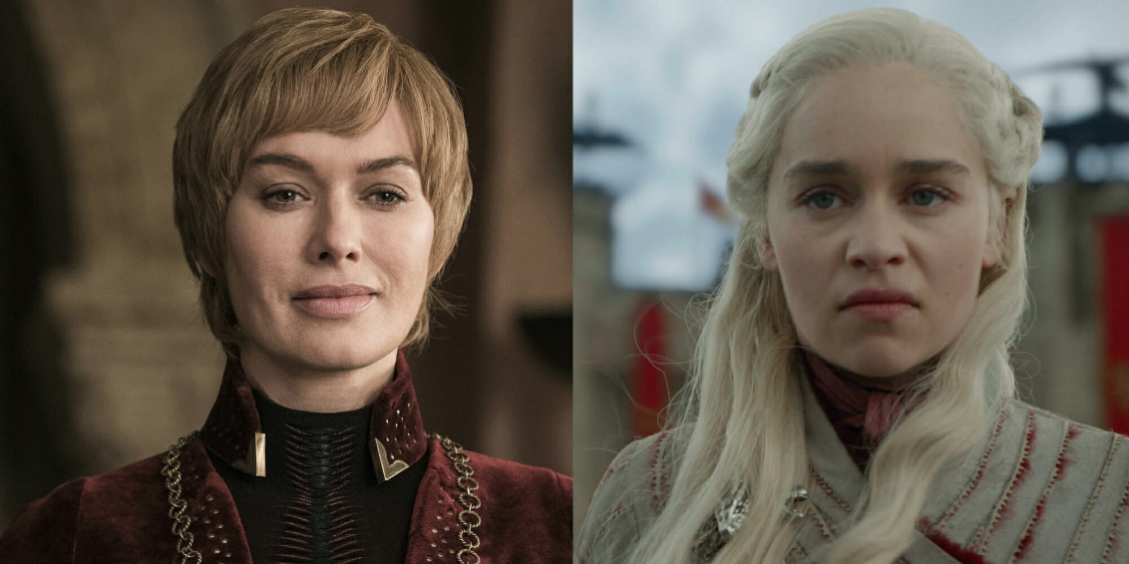
Cersei Vs. Daenerys - Who said “Kill” more often?
 | Cersei | Daenerys
freq("kill") | 0.445% | 0.628%
 | Cersei | Daenerys
freq("love") | 0.691% | 0.240%
Notes:
In the table, it indicates that Daenerys said to kill more frequently than Cersei did.

Slide 22
Cersei Vs. Daenerys - Who said “love” more often?
 | Cersei | Daenerys
freq("love") | 0.691% | 0.240%
Notes:
and Cersei said love more frequent than daenerys did.

Slide 23
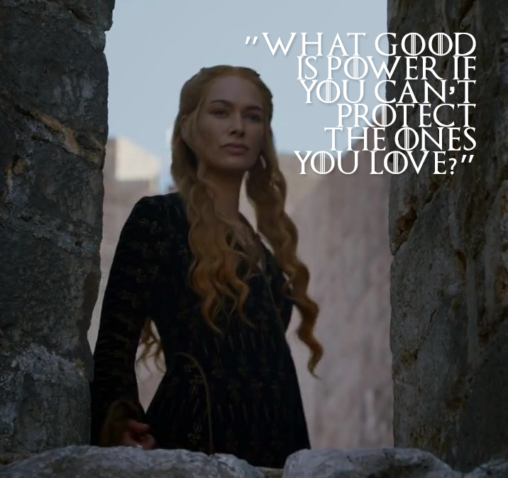
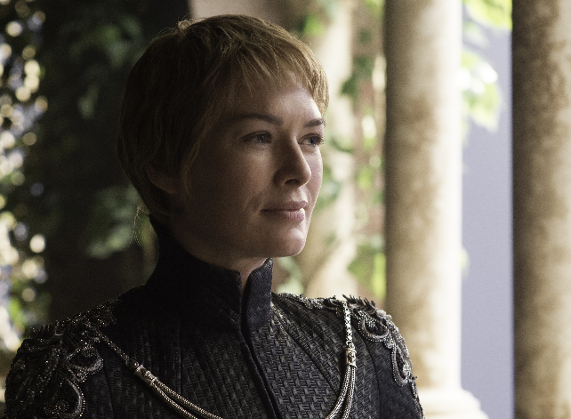
Cersei is the better queen.
?
Notes:
If you believe that mercy is the most important quality of a leader, then Cersei is the better queen based on our research
But maybe it’s too early to draw a conclusion. The information from the frequency of kill and love is very limited, so we are going to explore more clues to answer this question by deep down to the Cercei and Daenerys’ words cloud

Slide 24
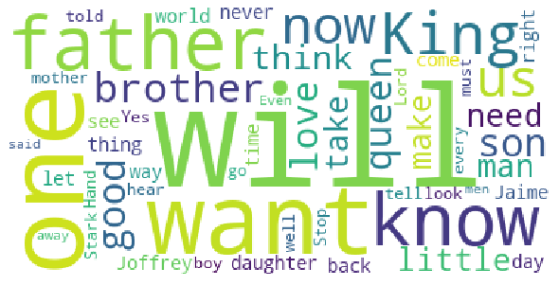
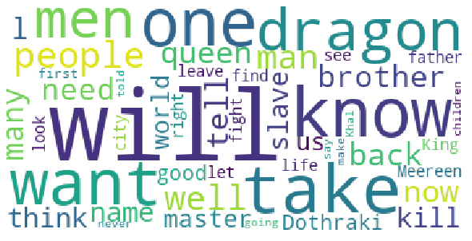
Cersei
Vs.
Daenerys
What other words do they say often?

Slide 25
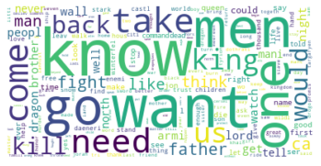

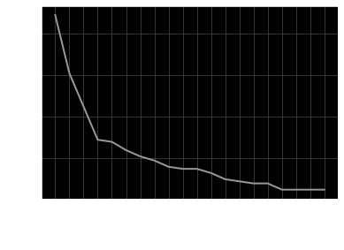
Targaryen
This family is one of the forerunners for the throne.
Their need for the throne is visible from the words “Want” “Know” “Kill” “Take” “Need”

Slide 26

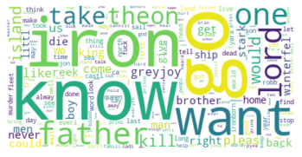
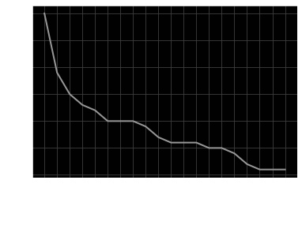
Greyjoy
Patriarchal family “father” “lord”
Obsessed with the Iron Throne “Iron”
Their need for the throne is visible from the words “Want” “Know” “Kill” “Take” “Need”

Slide 27

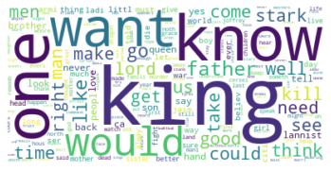
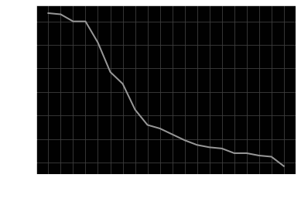
Lannister
Patriarchal family “father” “king”
Targaryen and Stark are rivals “Queen” “Stark”
Their need for the throne is visible from the words “Want” “Know” “Kill” “Take” “Need”

Slide 28
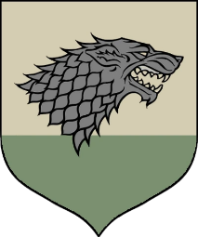
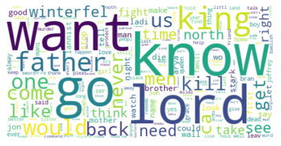
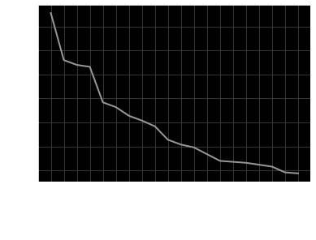
Stark
Patriarchal family “father” “king”
Key family involved in WinterFall “Winterfell”
Their need for the throne is visible from the words “Want” “Know” “Kill” “Need”

Slide 29

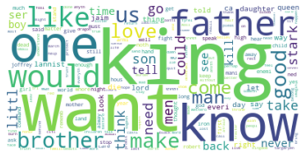
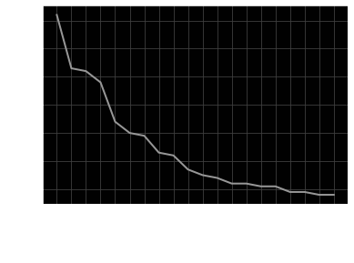
Baratheon
Patriarchal family “father” “king”
Brotherhood is important “Brother”
“Stark” is of high importance to them
Their need for the throne is visible from the words “Want” “Know” “Need”

Slide 30

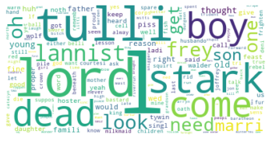
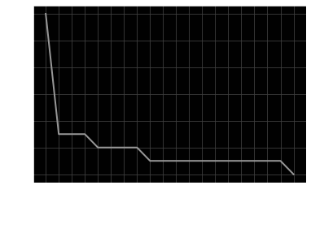
Frey
Obsessed with families “Stark” “Lannister” “Tully”
Witnessed more death “Dead”
Young family “Boy” “Son”

Slide 31

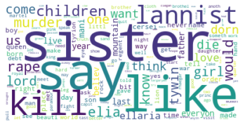

Martell
Very Violent Family “Murder” “Rape” “Kill”
Focused on females “Sisters” “Girl”
“Lannister” is of high importance to them

Slide 32
Practical Implications
Script analysis is an important tool for directors, designers, and actors to master.
Script analysis helps professionals such as television producer or director, screenwriter, and actors to better understand how the show is a triumph in storytelling of characters, plot twists, dialogues, and emotions.
Notes:
According to Dr. Paul Mroczka, an Associate Professor of Theatre and Director of Theatre at Plymouth State University, Script analysis is the major tool directors and others use in the theatre to turn a written script into the three-dimensional production, thus it is an important skill for directors, designers, and actors to master.
Not only the audience can gain a deeper insights of Game of Thrones using script analysis, it also help professionals such as television producer or director, screenwriter, and actors to better understand how the show is a triumph in storytelling of characters, plot twists, dialogues, and emotions.

Slide 33

Thank You !
Jack
yang
Jingnan
Qi
Oje
williams
Wei chi
yeh
Yichuan
hu
Sanket
Patel

Slide 34
References:
Dag Heward-Mills. ‘The Art and Science of Applied Leadership’.
Loria, S. (n.d.). Simplified Text Processing¶, Textblob
Mysiak, K. (2020, June 07). NLP Part 2: Preprocessing Text Data Using Python
Morris, R. (n.d.). Roz Morris - Editor, https://reedsy.com/roz-morris
Matthew 5:7. King James Bible. (n.d.). King James Bible Online
Mroczka, P. (2016, January 12). Script Analysis Basics for Students: Understanding the Play and Plot, Part Two. Broadway Educators.
Pallotta, F. (2019, April 30). 'Game of Thrones' epic battle sets viewership record, CNN
Schermerhorn, A. C. (n.d.). Family Influence, Science Direct

